Slide 1
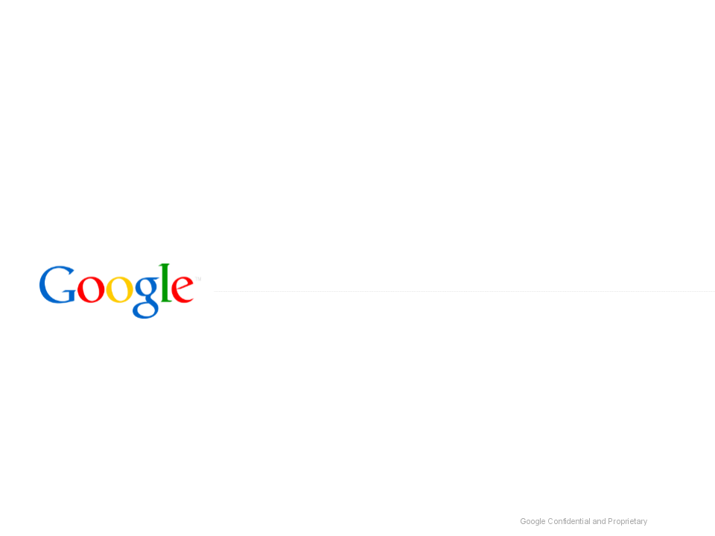

Search Techniques & Strategies
Which Link Should I Follow?
Web Search Lesson Plan
Module B1
Notes:
Inquiry questions: Which link should I follow? Which search result has what I need?
Students will learn to understand what the different parts of search results suggest about the content of the pages they offer.
Students will learn to interpret these results in order to pick the best sources without reading every page.

Slide 2

Make Google Work for You
Some Basic Facts

Slide 3

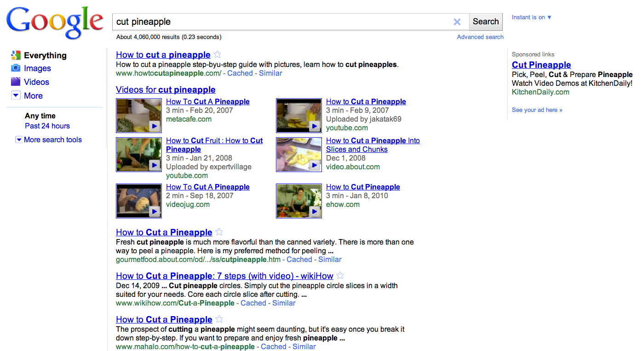
Choosing a Link
Does it matter which link you chose here?
Notes:
The teacher explains:
"If you were cutting up a pineapple for the first time, how would you learn to do it?"
Students guess how to search and anticipate how to read the search results.
For example, the query [cut pineapple] brings back a full screen of videos that show exactly how to do that successfully.

Slide 4
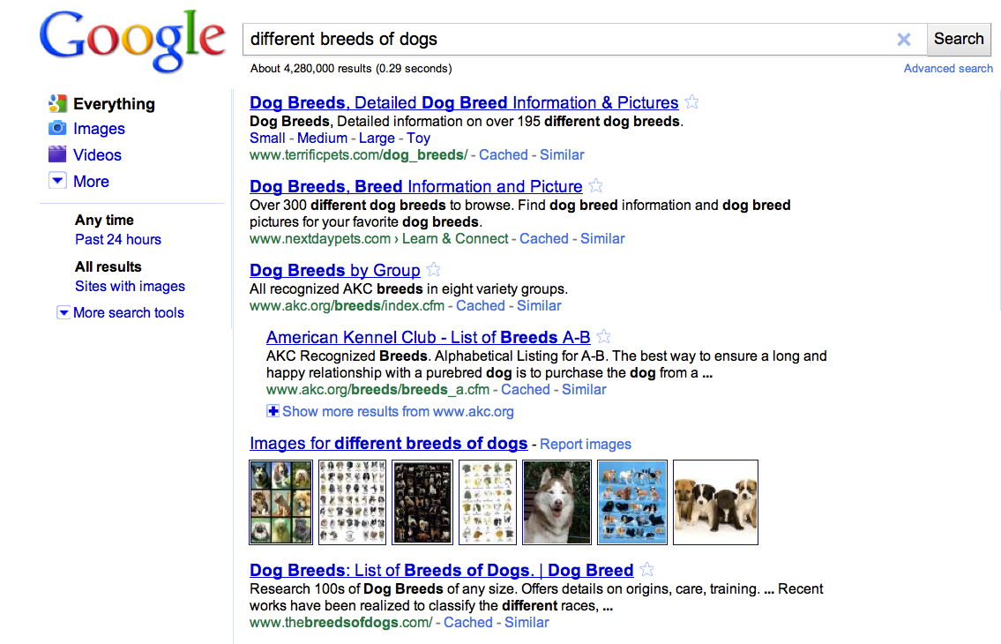
Link Choice Can Matter
Would link choice make a difference here?
Notes:
Then teacher explains:
“Now, let’s say you want to get a pet dog, but you think you want a pure-breed so you can compete in dog shows. If you search for what different breeds of dogs there are, how do you pick which page to visit?”
Brings back pages:
snippets indicate various numbers of types of breeds (one indicates “over 195,” another “over 300”)
middle of the page is the American Kennel Club, which speaks of “recognized” breeds
Ask what language indicates about why the website owner is talking about different breeds of dogs.
Alternatively, the teacher could have a search page open and take student guesses, but do not click on the links.

Slide 5
Give It a Try!
You are doing your homework on the early days of our country.
Which of these searches find a screen full of pretty helpful results, and where do you have to be more choosy?
[colonial life]
[american revolution]
[treaty of paris]

Slide 6
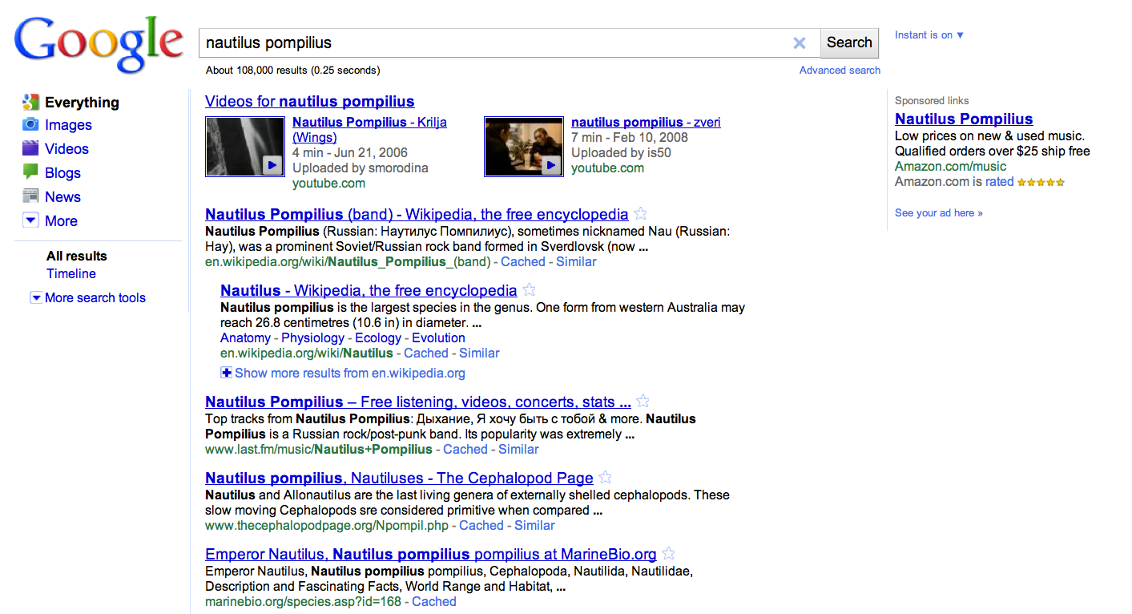
The Anatomy of a Search Results Page
What are these parts called?
Notes:
Discussion questions:
*How does Google search work? What do these search features mean?
*How can they help you decide which link to follow?
*Search results
Possible Answers:
These are the organic search results. The results are not influenced by sponsored links. Google does not sell results rank for search results. Organic search results and sponsored link results work from different and separate servers.
*Title
Possible Answers:
The name of the specific page you would visit if you clicked on that link.
*Snippet
Possible Answers:
A description of the content that you will find if you click on that search result. It may be written as a description, or it may be segments of the text of the page that show the words from your query.
*Web address
Possible Answers:
Also called a URL. The market for the unique location that webpage occupies on the Internet.
*Sponsored links
Possible Answers:
Google allows for ads with specific guidelines. Ads must be relevant to the search, not be distracting, and labeled clearly as "Sponsored Links". Google doesn't sell search results.
*Left Panel
Possible Answers:
The column of links down the left-hand side of the results screen. It suggests ways you might want to filter your results, and can be opened up to allow you to make a number of choices regarding how your results can be filtered and sorted.

Slide 7
The Anatomy of a Search Results Page
1
6
5
2
1. Search Result
2. Title
3. Snippet
4. Web Address
5. Sponsored Link (Ad)
6. Left Panel
4
3

Slide 8
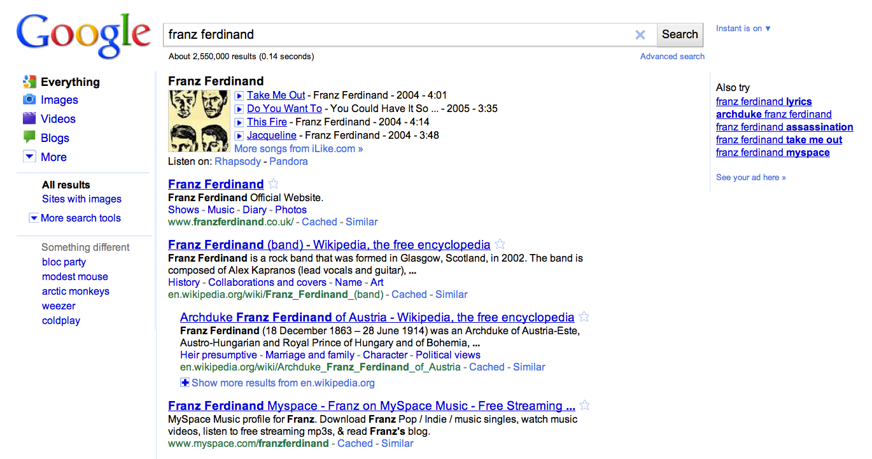
Ranking Results
How does Google's understanding of what I want affect the order of my search results?
Notes:
Google ranks results, showing you those that it thinks best fit your query first.
Google uses a specific calculation to determine both which results and where results appear on the search results page.
This calculation is based on similar (relevant) pages and web pages with hyperlinks to those pages.
So, the more popular and relevant a particular website, the more likely it will be ranked higher and indexed on the results page.
Google search is constantly being revised to make sure the most useful results appear on top.
Funny story: Lead singer of Franz Ferdinand, Alex Kapranos, gave interview.
He once said he would know if his band had "made it" when they occupied the first place in the search results!
Have they made it?

Slide 9

Predicting the Best Source
Tips for Finding What You Want

Slide 10
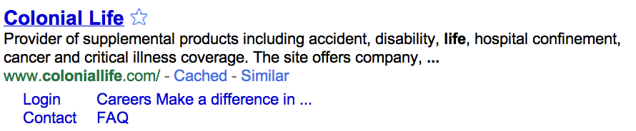
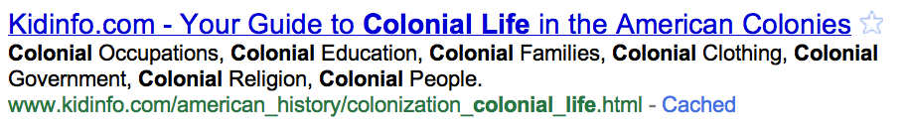
Think About What You See
What clues tell you if these results are about life in the American Colonies?
Notes:
The first step in picking a link is thinking about what you see.
Look at the two search results.
Discuss what clues students see that help them decide which would be good to click.

Slide 11
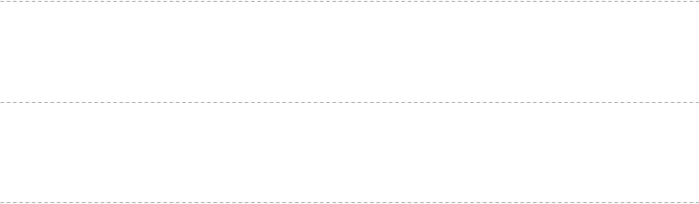
Tips for Understanding Web Addresses
1
Have I heard of the domain?
For example: nytimes.com, lostagoodnews.com
2
What type of domain is it?
For example: .com, .edu, .gov, .ru, .info, etc.
3
Is there a symbol (% or ~) or name, showing it is a personal page?
For example: %, ~, dchen, member, user
4
Is the domain name from a personal page hosting website?
For example: Homestead.com, Geocities.com, Tripod.com
5
Does the address tell what kind of file it is?
For example: pdf, xls, jpg

Slide 12


Chose the Best Result
What am I looking for?
What do I really want? What do I think it will look like? What kind of site do I think it will be on?
Do the words I see match my needs?
Do the snippet and title use the words I looked for in the same way I do? Are there other words that tell me it is about something else?
Go to the
next result
What does the web address tell me?
Which of these keywords are common or general words? Which would be more specific? Are there better words I could use?
Go to the next result
What kind of results am I looking for?
Do I want a definition, a database, a list, a map, an image, a video, or something else?
Do I want a presentation, a spreadsheet, or something else?
Go to the
next result
Click!
Remember: look at a full screen of results before deciding!

Slide 13
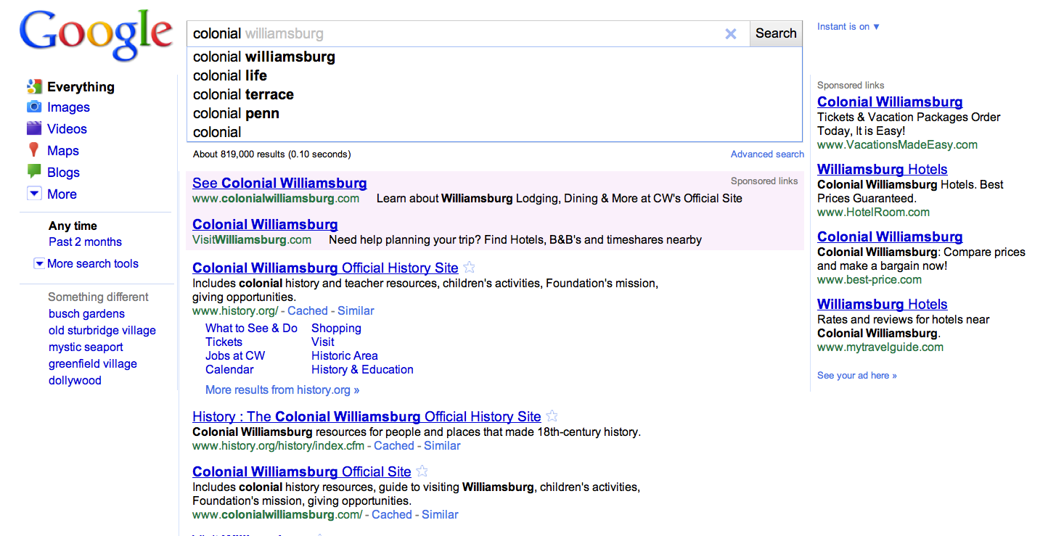
Working with Instant Search
Notes:
Instant Search
Type slowly:
[colonial life in america]
Let students observe how results change--not relevant, relevant, not relevant, relevant.....

Slide 14
Give It a Try!
What can I learn about my results from these web addresses?
www.history.navy.mil/faqs/faq56-1.htm﻿
www.sjsu.edu/faculty/watkins/taiping.htm
britishbattles.homestead.com/eastasia.html
www.redcoat.me.uk/Rev-War.htm
scs.student.virginia.edu/~vjil/PDF/48_249-306.pdf
Try a search and discuss what links you would chose. Give evidence for your results.
Type [walk the plank] into your Google search bar very slowly. What different searches does Google Instant think you are doing while you type?

Slide 15

This lesson was developed by:
Tasha Bergson-Michelson
Trent Maverick
This lesson is licensed under a Creative Commons Attribution-Share-Alike license. You can change it, transmit it, and show it to other people. Just always give credit to Google.com ("Attribution"), and make sure that any works you make based on these lessons are also under the same Creative Commons Attribution-Share-Alike license ("Share-Alike").
http://creativecommons.org/licenses/by-sa/3.0/legalcode.

